Slide 1
Modern Programming Languages
UIIT PMAS Arid Agriculture University, Rawalpindi
Course Instructor: Suleman Khurram

Slide 2
Garbage Collection
Garbage collection is an important feature of java
collection frees the programmer from having to worry about releasing objects that are no longer needed
There is no concept of explicit pointers in Java, hence preventing from dangling pointers and memory leaks
There are two basic principles of garbage collection
Find data objects in a program that will not be accessed in the future
Reclaim the resources used by those objects

Slide 3
Class
A class is a prescription for a particular kind of object—it defines a new type.
A class is a representation for a conceptual grouping of similar items or a template.
class definition
There are two kinds of things that you can include in a class definition
Fields—These are variables that store data items that typically differentiate one object of the class from another.
They are also referred to as data members of a class.
Methods—These define the operations you can perform for the class—so they determine what you can do to, or with, objects of the class.
Methods typically operate on the fields—the variables
of the class.

Slide 4

Object
An object of a class is also referred to as an instance of that class. When you create an object, the object will contain all the fields that were included in the class definition
Instance of

Slide 5
Object Example
Class Student{
String status;
String defaulter;
Public Boolean isEligible(){
}
}
Instance of
Class StudentObjectExample{
public static void main(String [] args){
Student john=new Student();
john.status=“enrolled”;
john.defaulter=“no”;
}
}

Slide 6
Fields/Data members in class definition
Also referred to as Member variables
Here are two types of fields in a class definition
Static Fields/class variables
Non-static Fields/instance variables

Slide 7
Static Fields/class variables
Shared by all objects of the class
There is only one copy of static fields for all variables of a class.
They exist even if there is no object of the class
StaticExample
Static int: noOfInstances=0
Public void increment()
obj1
obj2
obj3
Obj2.increment()
Obj1.increment()
Obj3.increment()
noOfInstances=1
noOfInstances=2
noOfInstances=3

Slide 8
Static Fields/class variables
Class StaticExample{
static int noOfInstances=0;
public void increment(){
noOfInstances++;
System.out.println(“No of instances are ”+noOfInstances);
}
public static void main(String[] args){
StaticExample var1 =new StaticExample();
var1.increment();
//It will display 1
StaticExample var2 =new StaticExample();
var2.increment();
//It will display 2
}
}

Slide 9
Non-static Fields/instance variables
Each object of the class will have its own copy of each of the non-static fields or instance variables that appear in the class definition.
Each object will have its own values for each instance variable.
Student
String name;
obj1
obj1
Name=John
Name=Edward

Slide 10
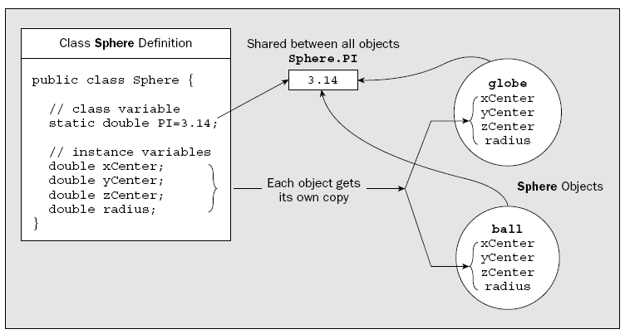
Example

Slide 11
Methods in Class Definition
The methods that you define for a class provide the actions that can be carried out using the variables specified in the class definition.
Methods of a class specify the behavior of an object
There are two types of methods in a class definition
class methods/Static methods
instance methods/Non static methods

Slide 12
Static Methods/Class methods
You can execute class methods even when no objects of a class exist
class methods are declared using the keyword static, so they are sometimes referred to as static methods
Static methods can not use any instance variables

Slide 13
Non Static methods/ Instance methods
Instance methods can be executed only in relation to a particular object, so if no objects exist, you have no way to execute any of the instance methods defined in the class

Slide 14
Assessing static and non-static methods
double rootPi = Math.sqrt(Math.PI);
Ball ball=new Ball();
double ballVolume = ball.volume();
Static method
Non static method

Slide 15
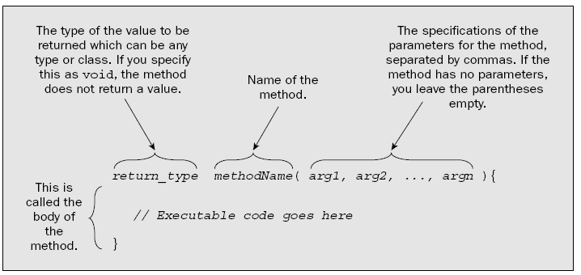
Defining Methods

Slide 16
Example:Assessing Data members/ Fields in a method
public class Bicycle {
// the Bicycle class has three fields
public int cadence;
public int gear;
public int speed;
public void setGear(int newValue) {
gear = newValue;
}
}

Slide 17
Example: Assessing Data members/ Fields in a method
class Sphere {
//class variables
static final double PI = 3.14;
static int count = 0;
// Instance variables
double radius;
double xCenter;
double yCenter;
double zCenter;
//static method
static int getCount(){
return count; // Return current object count
}
// Instance method to calculate volume
double volume() {
return 4.0/3.0*PI*radius*radius*radius;
}
}

Slide 18
The Variable this
Every instance method has a variable with the name this that refers to the current object for which the method is being called
void changeRadius(double radius) {
// Change the instance variable to the argument value
this.radius = radius;
}

Slide 19
Initializing data members: The ordinary way
class Sphere {
static final double PI = 3.14; // Class variable that has a fixed value
static int count = 0; // Class variable to count objects
// Instance variables
double radius = 5.0; // Radius of a sphere
double xCenter = 10.0; // 3D coordinates
double yCenter = 10.0; // of the center
double zCenter = 10.0; // of a sphere
// Rest of the class...
}

Slide 20
Using Initialization Blocks
There are two kinds of initialization blocks:
static initialization block
non-static initialization block

Slide 21
static initialization block
A static initialization block is a block defined using the keyword static and is executed once when the class is loaded.
A static initialization block can initialize only static data members of the class.
A static initialization block is a normal block of code enclosed in braces, { }, and preceded by the static keyword. Here is an example: static { // whatever code is needed for initialization goes here }

Slide 22
Non-static initialization block
non-static initialization block is executed for each object that is created and thus can initialize instance variables in a class.
This block appears without the static keyword
{
// whatever code is needed for initialization goes here
}

Slide 23
Constructors
Constructer is a special kind of method which is always invoked when an object of the class is created
The primary purpose of a constructor is to provide the means of initializing the instance variables uniquely for the object that is being created

Slide 24
Constructer characteristics
A constructor has two special characteristics that differentiate it from other class methods:
A constructor never returns a value, and you must not specify a return type—not even of type void.
A constructor always has the same name as the class.

Slide 25
Constructer Example
class Sphere {
static final double PI = 3.14;
static int count = 0;
double radius; // Radius of a sphere
double xCenter; // 3D coordinates
double yCenter; // of the center
double zCenter; // of a sphere
// Class constructor
Sphere(double theRadius, double x, double y, double z) {
radius = theRadius; // Set the radius
// Set the coordinates of the center
xCenter = x;
yCenter = y;
zCenter = z;
++count; // Update object count
}
}

Slide 26
Default Constructor
If you don’t define any constructors for your class, the compiler will supply a default constructor in the class, which does nothing.
class Sphere {
.
.
.
Sphere() {
}
}

Slide 27
Creating Objects of class when a constructer is used
public static void main(String[] args){
Sphere s1=new Sphere(2,3,4,5);
System.out.println("here comes the constructer");
}

Slide 28
Task
Create a class Employee with following attributes
Name
Salary
designation
Add a constructor to initialize the instance variables of the class.
Create objects of the class by using constructers
Add other methods of the class to specify other behaviors of the object

Slide 29
Passing objects as parameters
Every class is a Type
Hence, objects of a class can be passed to a method like parameters of any other data type.
public static void main(String[] args){
Sphere s1=new Sphere(2,3,4,5);
Sphere s2=new Sphere(0,0,0,0);
s2.copySphere(s1);
}

Slide 30
OVER LOADING
Defining two or more methods with the same name in a class is called method overloading.
Java allows you to define several methods in a class with the same name, as long as each method has a unique set of parameters.

Slide 31
Method Overloading
Two methods in a class can have the same name provided
they take different numbers of arguments,
or
the type of at least one argument is different
public int add(int value1,int value2){
}
Public float add(float value1,float value2){
}

Slide 32
Method Overloading
The compiler does not consider return type when differentiating methods
We cannot declare two methods with the same signature even if they have a different return type.
public int countRows(int number); public String countRows(int number);
public String printString(String string) public String printString(String string, int offset)

Slide 33
Method Overloading Example
public class MainClass { public void print(int a) { System.out.println(a); } public void print(String a) { System.out.println(a); } }

Slide 34
Multiple Constructors
Constructors are methods that can be overloaded, just like any other method in a class.

Slide 35
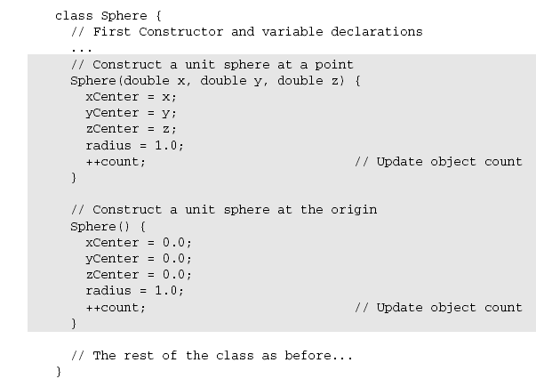
Multiple Constructors Example

Slide 36
Creating objects using multiple constructors
Sphere eightBall = new Sphere(10.0, 10.0, 0.0);
Sphere oddBall = new Sphere();

Slide 37
Calling a Constructor from a Constructor
One class constructor can call another constructor in the same class in its first executable statement.
This can often save duplicating a lot of code.

Slide 38
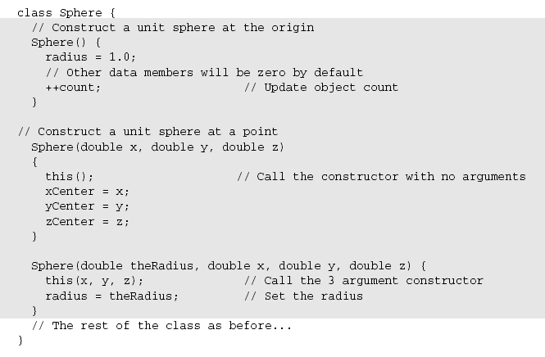
Calling a Constructor from a Constructor: Example

Slide 39
Task 1
Make a class with the name Calculator
Identify methods and data members of the class and add basic behavior to the class such as
Add
Subtract
Divide
Multipy etc.

Slide 40
Task 2
You have already made a class with the name calculator
Overload its methods to cater different data types
Overload its constructors properly

